Slide 1
TEAM INTRO
TITLE NAME: REFLECTION REMOVAL AI MODEL,TECHFEST 2024-25, QUALCOMM Vision X CHALLENGE
TEAM NAME/ID: TEAM ROCKS / QUAL-230364
TEAM MEMBERS: MANGESH TIWARI (ML DEVELOPER)
TANISH PALKAR (OPENCV DEVELOPER)
YASH PATHAK (ML DEVELOPER)
KRUNAL WAGHELA (UI DESIGNER)
COLLEGE/UNIVERSITY: ST. FRANCIS INSTITUTE OF TECHNOLOGY
DATE OF SUBMISSION: 20TH NOVEMBER 2024

Slide 2
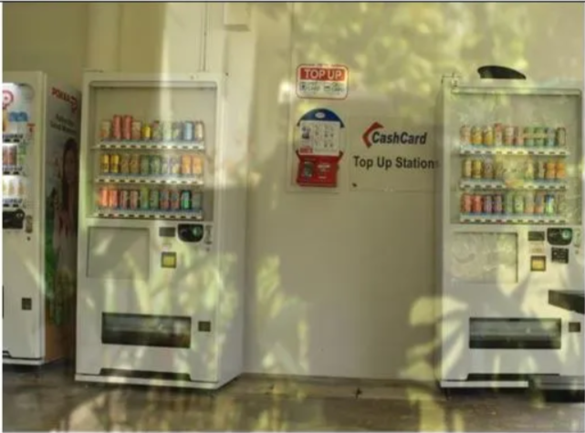
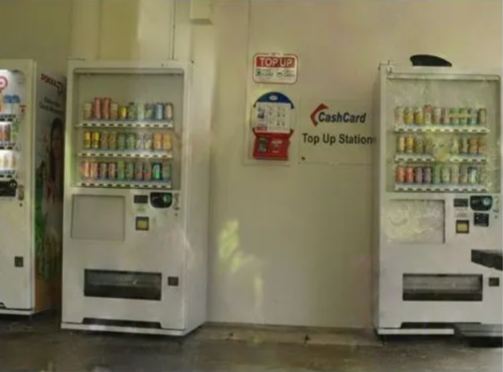
EXECUTIVE SUMMARY
Project Overview: This project develops an AI model for removing reflections from images captured through reflective surfaces like glass or water.
Main Objective: To enhance image clarity by removing reflections, without introducing blur or losing image detail.
Applications: Security, Autonomous Vehicle, and Photography fields that require clear and distortion-free images.
INPUT IMAGE
OUTPUT IMAGE

Slide 3
Problem Statement
Challenge: Reflections in images can obscure important details, reducing usability in fields such as security and navigation.
Goal: Create an AI that removes reflections across different lighting and surface types.
Expected Outcome: Clear, accurate, and usable images that retain detail and structure after reflection removal.

Slide 4
Technical Approach
Model Choice: CNN-based Encoder-Decoder model for detecting and removing reflections.
Additional Methods: Integration of SSIM (Structural Similarity Index) and PSNR (Peak Signal-to-Noise Ratio) to maintain image quality.
Enhancement: Potential use of GAN (Generative Adversarial Network) to handle complex reflections.

Slide 5
Dataset Overview
Dataset Selection: A combination of three datasets provides a comprehensive training foundation
SIR^2 - Real-world reflections captured under various settings to help the model learn realistic reflection patterns.
REAL275 - Provides diverse lighting conditions and reflective surfaces, enhancing the model’s ability to generalize across environments.
Synthetic Reflections on COCO - Custom reflections added to the COCO dataset allow us to test and fine-tune model performance under controlled conditions.
Objective: By using diverse data sources, we ensure the model can handle a range of reflection types in real-world scenarios.

Slide 6
Data Augmentation Strategy
Augmentation Techniques: Training data is augmented to improve adaptability
Lighting Variations: Simulates different times of day and indoor vs. outdoor lighting, enhancing model flexibility.
Surface Textures: Includes reflections on surfaces like glass, water, and polished metal.
Reflection Intensity Scaling: Trains the model to handle both weak and strong reflections
Purpose of Augmentation: Prepares the model for variable real-world conditions, ensuring consistency in reflection removal across multiple scenarios.

Slide 7
Model Training and Quality Control
Training Process: The model is trained on augmented datasets and fine-tuned with specific metrics to ensure optimal reflection removal. Datasets with both natural and synthetic reflections are used to expose the model to diverse scenarios.
Metrics for Quality Control:
SSIM (Structural Similarity Index): Maintains the natural structural detail of the image, preventing unwanted distortions.
PSNR (Peak Signal-to-Noise Ratio): Ensures that image quality remains high, with minimal noise or blur after processing.
Objective: Provide consistently clear and accurate output by balancing reflection removal and quality preservation.

Slide 8
Applications - Real-World Use Cases
Security Cameras: Eliminates reflections in surveillance footage, allowing clearer visibility of surroundings and improving security monitoring.
Autonomous Vehicles: Reduces reflections on windows, enhancing object detection and navigation accuracy in vehicles
Photography: Produces clear, professional-quality images by removing unwanted reflections in photos taken through glass or water surfaces.
Additional Fields: Potential applications in medical imaging, augmented reality (AR), and retail.

Slide 9
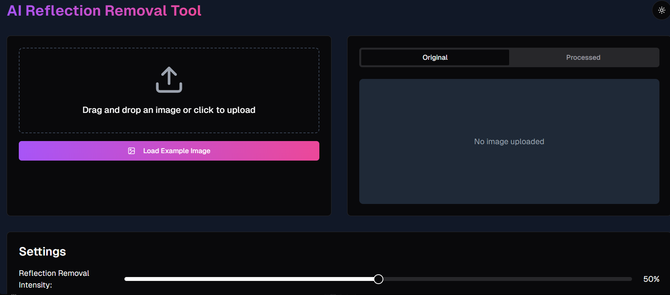
Application UI
User Interface Design: Concept for a streamlined interface allowing users to upload images, preview the reflection removal effect, and adjust settings as needed.

Slide 10
Competitive Advantage and Summary
Competitive Advantage: Our model’s adaptability and precision give it a unique edge. It’s designed to maintain high-quality output in various lighting and surface conditions, making it ideal for professional and personal use.
Precision and Reliability: Delivers clear images by removing reflections accurately, without adding blur or losing essential details.
Future Applications: Our technology is scalable and applicable across a range of industries, including security, autonomous driving, photography, and AR.
Closing Statement: Our AI model for reflection removal is a breakthrough for creating clear, usable images in reflection-heavy environments. Its versatility and adaptability make it a valuable tool for multiple fields, addressing a common imaging challenge.

